Slide 1
LSTM

Slide 2
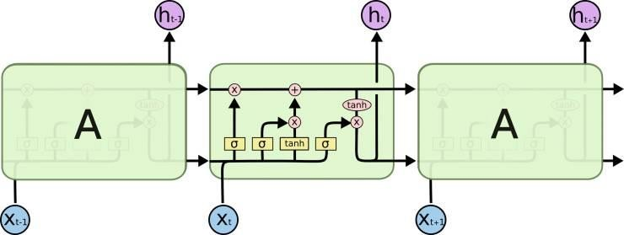
LSTM

Slide 3
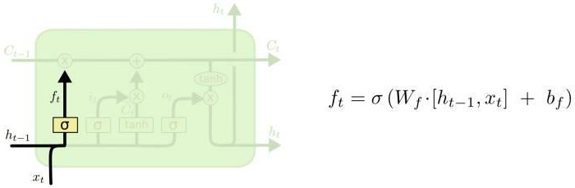
LSTM
遗忘门

Slide 4
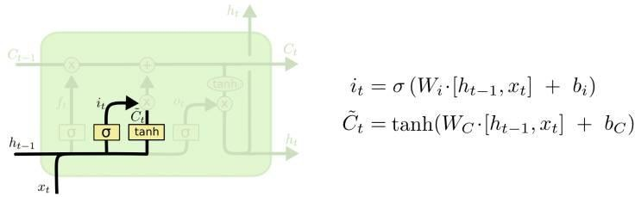
LSTM
输入门

Slide 5
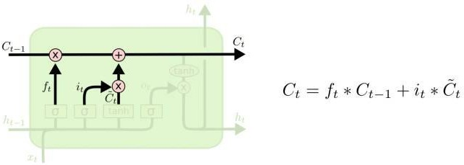
LSTM
细胞状态

Slide 6
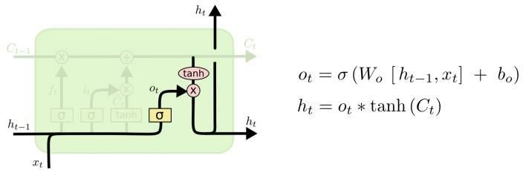
LSTM
输出门

Slide 7
Thanks Q&A

Slide 8

